Slide 1
CS 4215: Quantitative Performance Evaluation for Computing Systems
Lydia Y. Chen
y.chen-10@tudelft.nl

Slide 2
Opt

Slide 4
Last week
Characterization
Modeling
Predicting
Resource management

Slide 5
Optimization Formulation

Slide 7
Key Element
Linear programing
Linear objective and constraints
Solver: simplex methods (closed form)
Integer programming
Non-linear programming
Convex objective
Non-convex objective
With constraints
Without constraints

Slide 8
Minimize Sever Cost

Slide 9
Minimize Latency

Slide 10

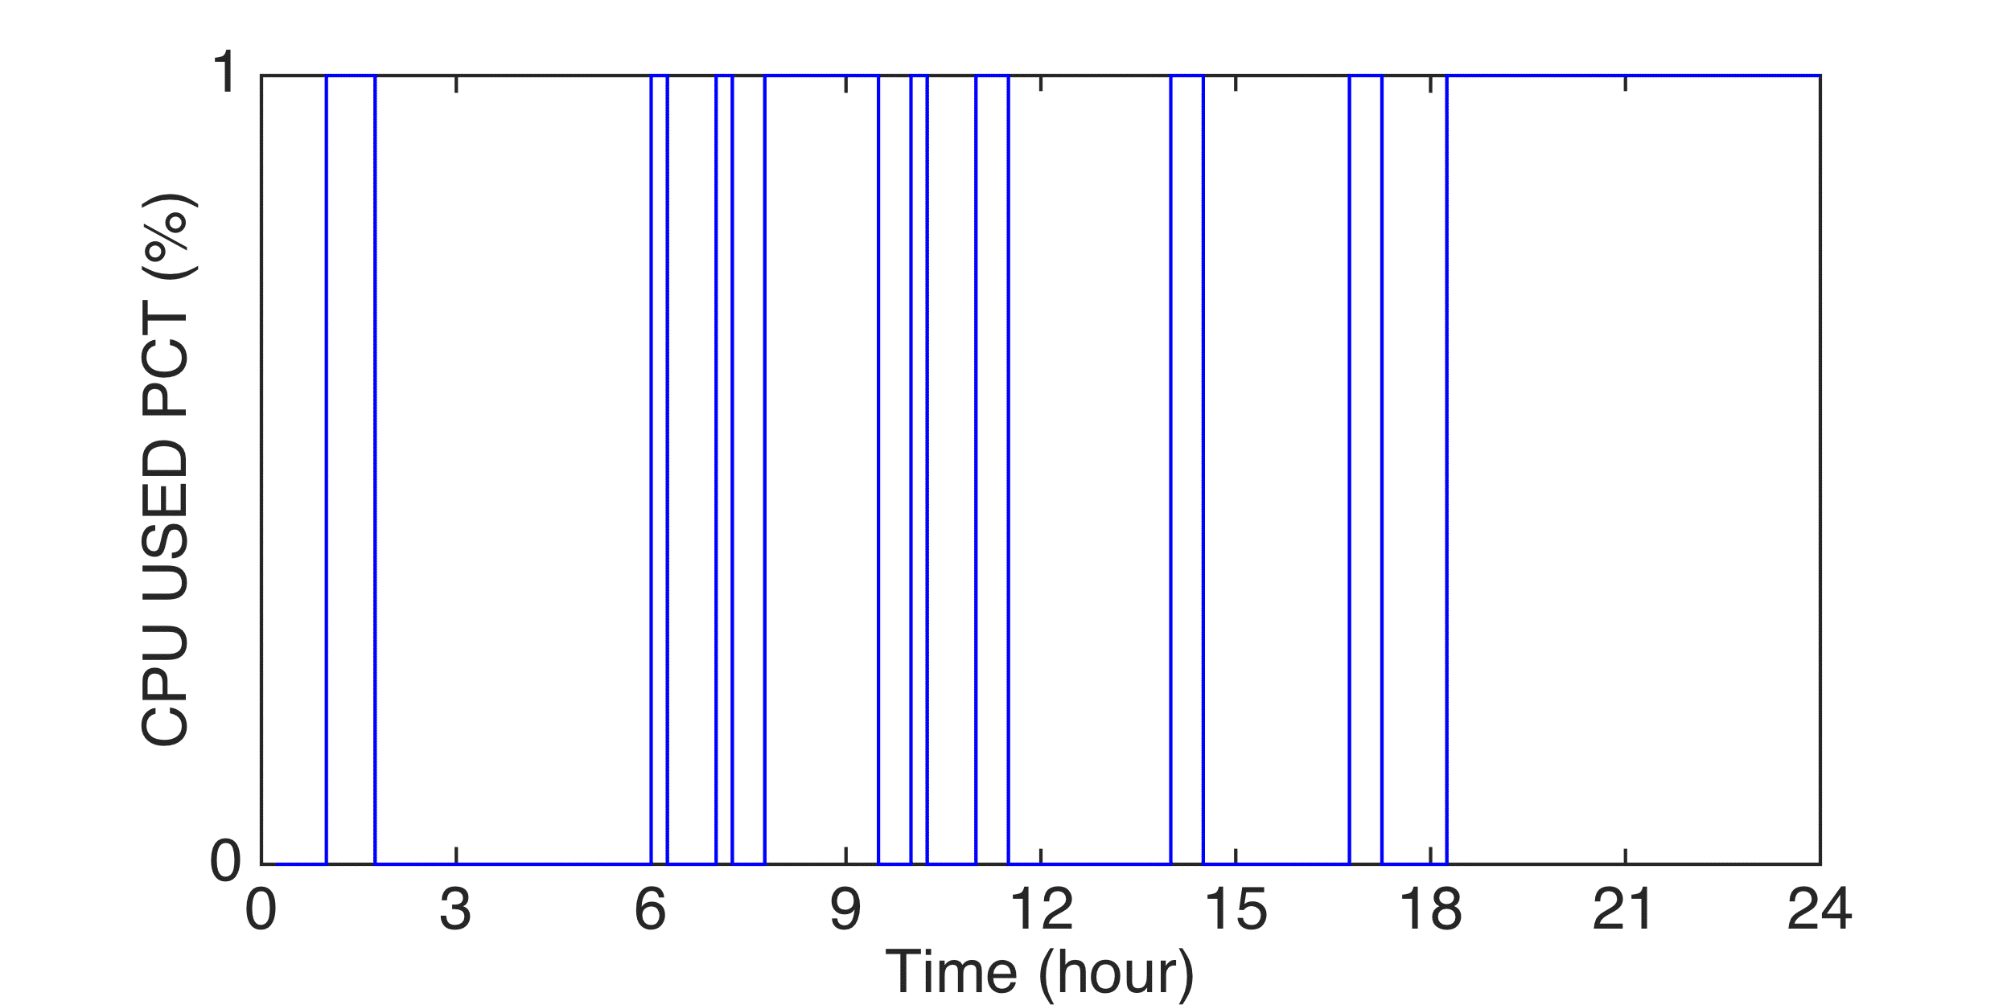
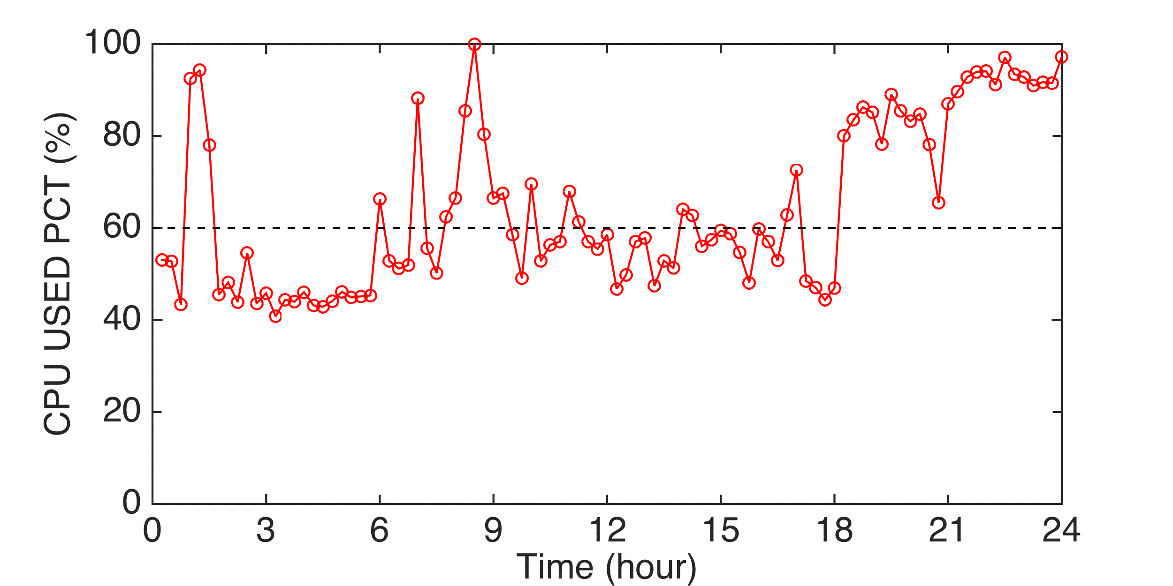
Example of VM Sizing
At datacenters, when the demand exceeds the certain percentage of resource resource supply, tickets will be automatically issue. E.g., CPU usage exceed 60%.
Assuming the demands in the future are now (through prediction), how much resource shall be allocated to each VM
Constraint that the total allocated resources should be less than physical capacity
Ticketing points
Monitor
CPU
MEM
DISK
NET
CPU
MEM
DISK
NET
CPU
MEM
DISK
NET
VM₁
VM_{i}
VM_{n}
…...
…...
BOX

Slide 11
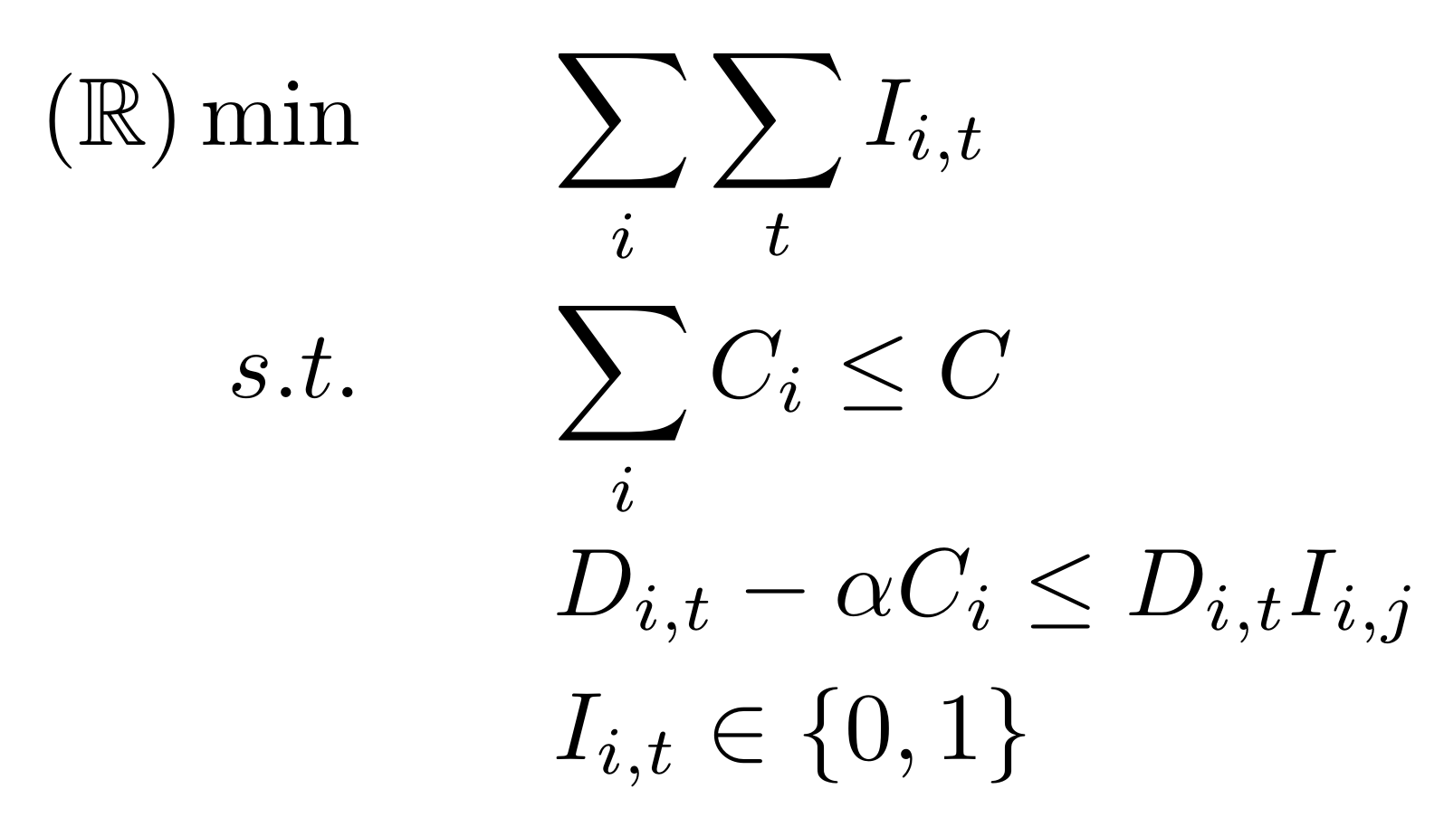
Ticket Minimization Formulation
I_{i,t} indicates ticket at VM i at time t
Sum of VM capacities C_{i} less than available total capacity
Force I_{i,t} to one if VM demand is higher than threshold α
Active resizing:
Reshuffle the virtual capacity to minimize the number of tickets
Formulated as mixed integer linear programming (MILP)
Complexity greatly depends on number of integer variables

Slide 12
Problem Transformation
D_{i}
D’_{i}
P_{i}
Y_{i}
0
Choosing this capacity, 2 tickets will incur
1
2
3
4
5
t
7
D’_{i,v} possible capacity candidates for VM i
Auxiliary variables:
P_{i,v} number of tickets for each D’_{i,v}
Y_{i,v} indicator variable for capacity candidates

Slide 13
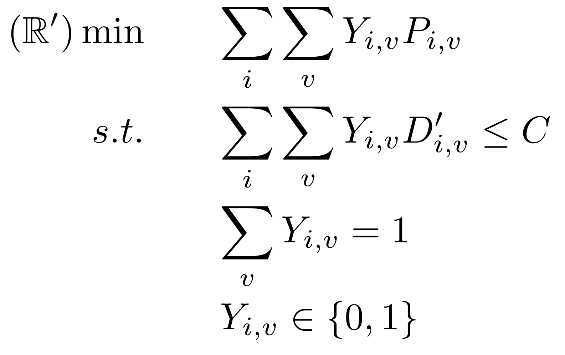
Problem Transformation:
Sum of tickets for chosen capacities
Sum of VM chosen capacities C_{i} below available total capacity
Force one candidate per VM
Transformed problem:
Choose one capacity candidate per VM to minimize overall tickets
Represents a multi choice knapsack problem
Efficient heuristics exist, e.g., [1]
[1] D. Pisinger, “A minimal algorithm for the multiple-choice knapsack problem,” 1995.

Slide 15
Optimization Solution

Slide 16
Optimization
Linear programing
Linear objective and constraints
Solver: simplex methods (closed form)
Non-linear programming
Convex objective
Non-convex objective
With constraints
Without constraints
Solving steps:
Check the type of programming
Change formulation, e.g., from primal to dual
Try to solve unconstrainted problem

Slide 17
Optimization Problems
General form:
Cost function
Constraint set example
Unconstraint if

Slide 18
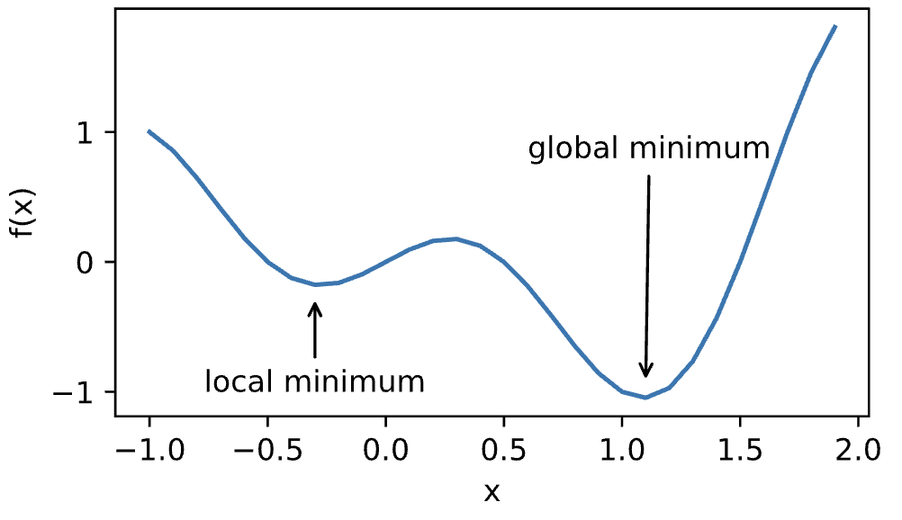
Local Minima and Global Minima
Most optimization problems have no close form solution
We then aim to find a minima through iterative methods
Global minima
Local minima , there exists

Slide 19
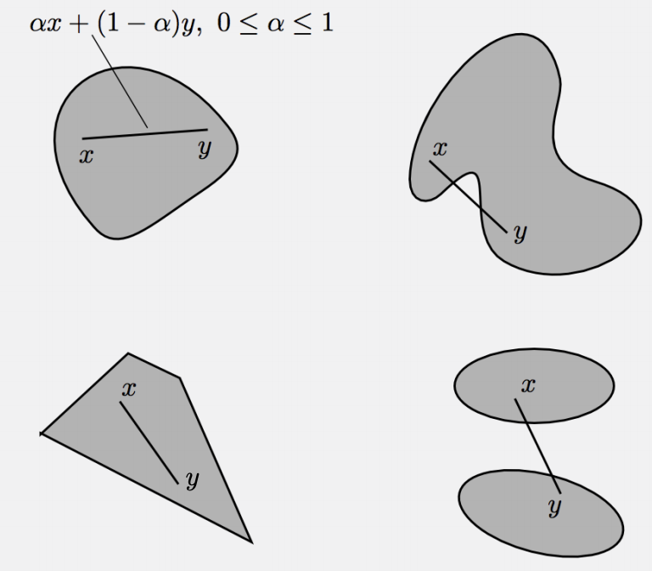
Convex Set
Which one is convex set?
A subset C of is called convex if

Slide 20
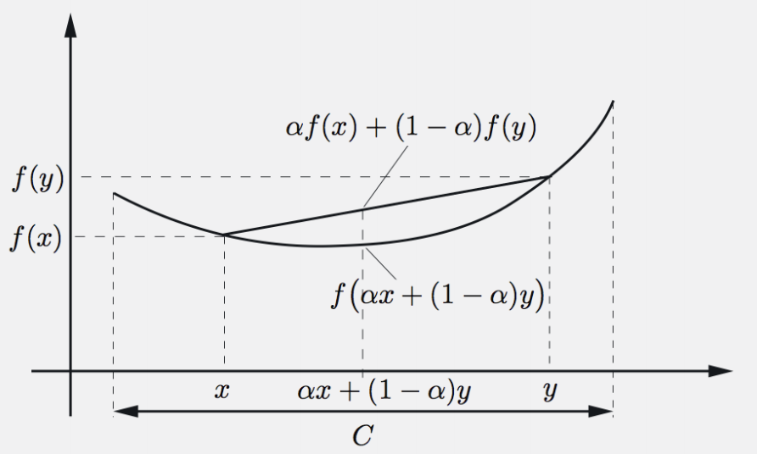
Convex Function
is called convex if
If the inequality is strict whenever
then f is called strictly convex
What are important criteria?

Slide 21
First-order condition
f is convex if and only if
If the inequality is strict, then f is strictly convex

Slide 22
Second-order conditions
f is convex if and only if
f is strictly convex if and only if

Slide 23
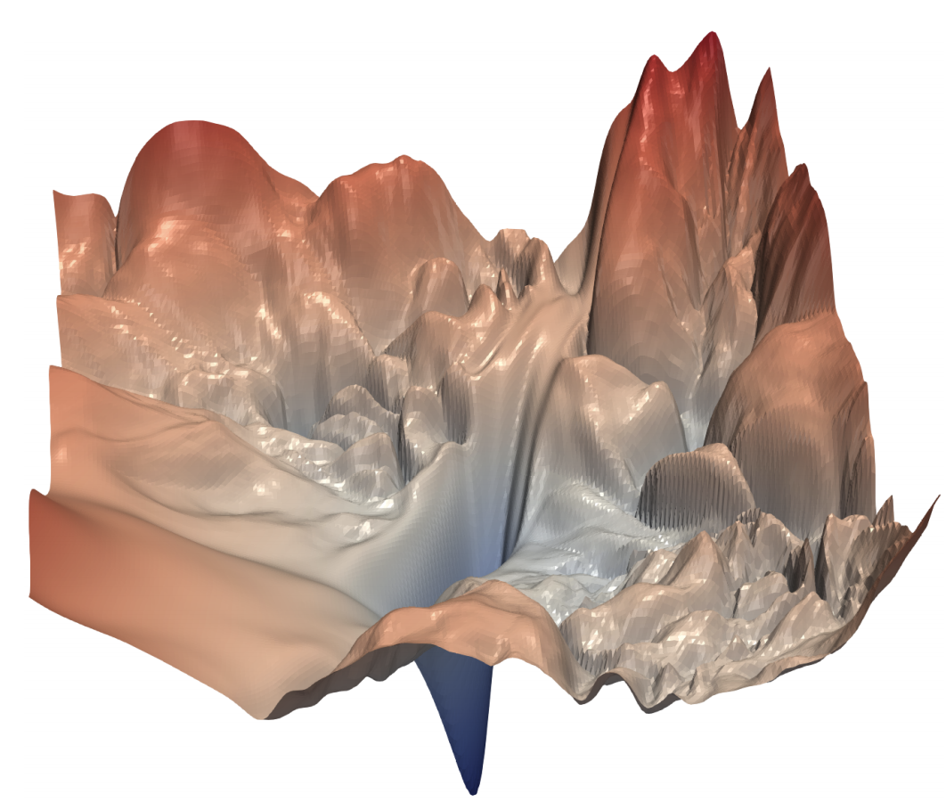
Convex and Non-convex Examples
Convex
Linear regression
Softmax regression
Non-convex
Multi-layer perception
Convolution neural networks
Recurrent neural networks

Slide 24
Convex Optimization
If f is a convex function, and C is a convex set, then the problem is called a convex problem
Any local minima is a global minima
Unique global minima if strictly convex
Global minima

Slide 25
Proof
Assume local minima , if exists a global minima
Choose
Then
Due to is a global minima, so
It contradicts X is a local minima

Slide 26
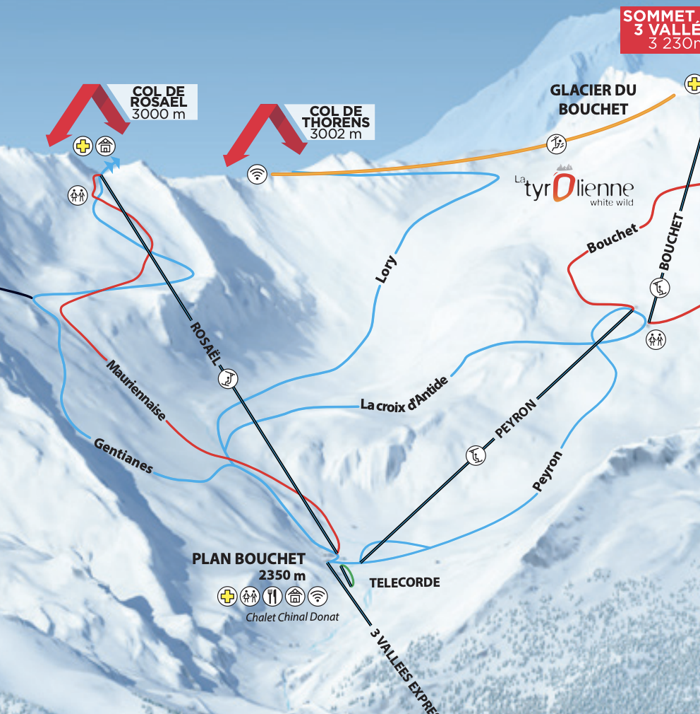
Gradient Descent

Slide 27
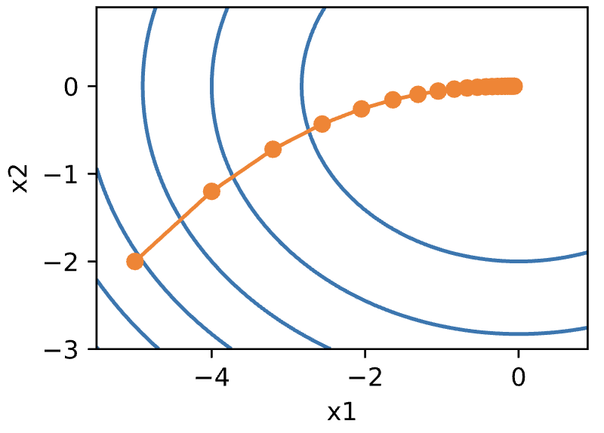
Algorithm
Choose initial
At time
is called learning rate

Slide 28
The Choice of Learning Rate
Given , for any f, by the Taylor expansion
Choose small enough learning rate

Slide 29
Convergence Rate
Assume f is convex, and its gradient is Lipschitz continuous with constant L
If use learning rate , after T steps
Convergence rate
To get , needs iterations
Gradient does not change dramatically

Slide 30
Proof
Gradient L-Lipschitz means
Plug in
Take
f decreases every time

Slide 31
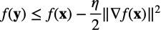
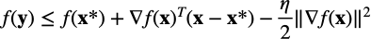
Proof II
By the convexity:
Plug in to

Slide 32
Proof III
Sum all T steps
f is decreasing every time:

Slide 33
Apply to Deep Learning
f is the sum of loss over all training data, x is the learnable parameters
f is often not convex, so the convergence analysis before cannot be applied
the loss for the i-th example

Slide 34
Stochast Gradient Descent
Singapore Dollar (SGD) 1000
~740 USD

Slide 35
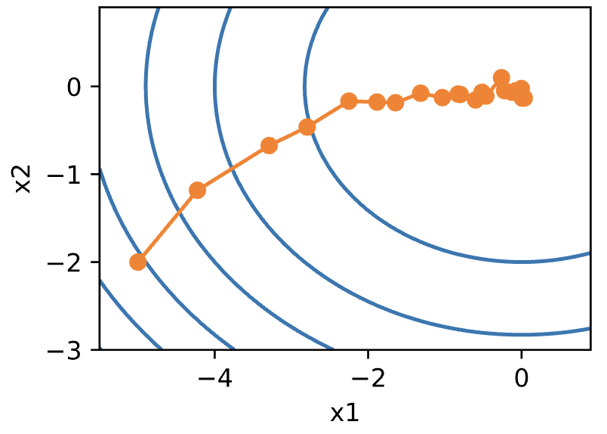
Algorithm
At time , sample example
Compare to gradient descent

Slide 36
Sample Example
Two rules to sample example it at time t
Random rule: choose uniformly at random
Cyclic rule: choose
Often called incremental gradient descent
Randomized rule is more common in practice
An unbiased estimate of the gradient

Slide 37
Convergence Rate
Assume f is convex with a diminishing , e.g.
Under the same assumption, for gradient descent
Assume gradient L-Lipschitz and fixed
Does not improve for SGD

Slide 38
In Practice
Does not diminish the learning rate so dramatically
We don’t care about optimizing to high accuracy
Despite converging slower, SGD is way faster on computing the gradient than GD in each iteration
Specially for deep learning with complex models and large-scale datasets

Slide 39
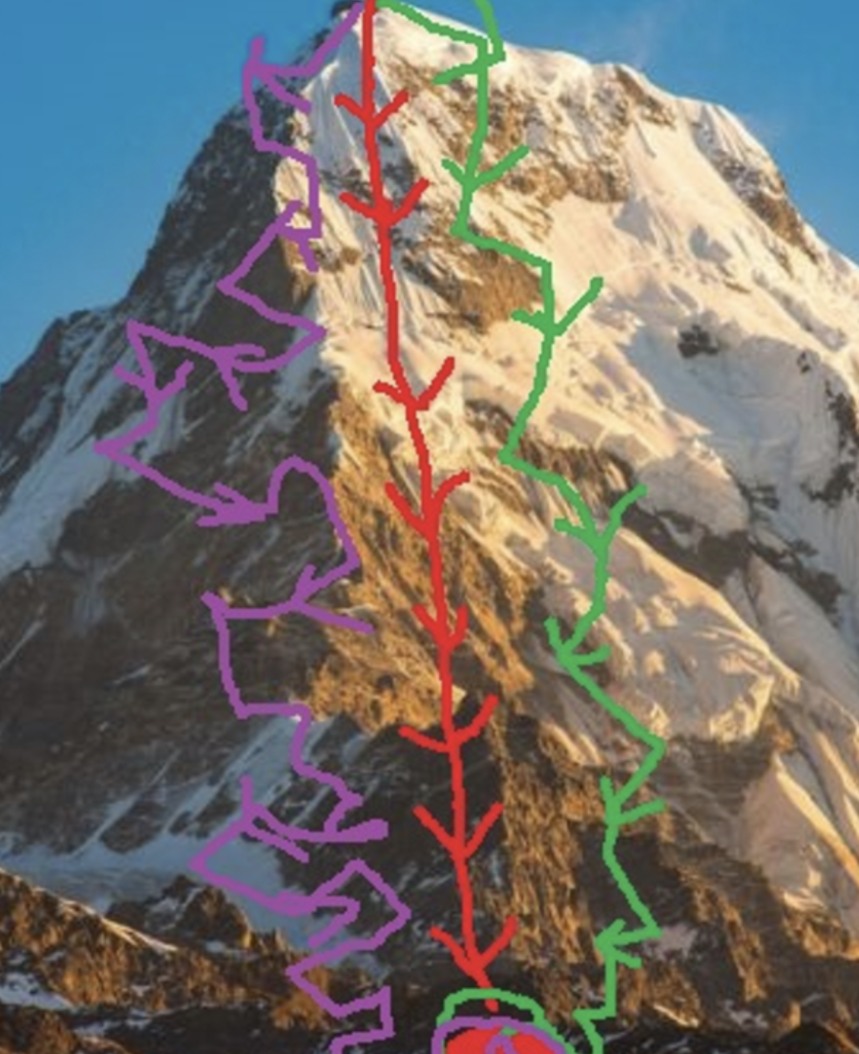
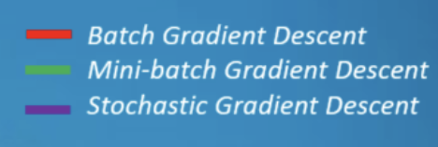
Mini-batch SGD

Slide 40
Algorithm
At time t, sample a random subset with
Again, it’s an unbiased estimate
Reduces variance by a factor of 1/b compared to SGD

Slide 41
Bonus quiz

Slide 42
Thanks!
Any questions?
You can find me at:
@username
user@mail.me

Slide 43
Presentation design
This presentations uses the following typographies and colors:
Titles: Raleway
Body copy: Lato
You can download the fonts on these pages:
https://www.fontsquirrel.com/fonts/raleway
https://www.fontsquirrel.com/fonts/lato
Dark blue #2185c5
Light blue #7ecefd
Yellow #ff9715
Magenta #f20253
Dark gray #677480
Light gray #97abbc
You don’t need to keep this slide in your presentation. It’s only here to serve you as a design guide if you need to create new slides or download the fonts to edit the presentation in PowerPoint®

Slide 44
SlidesCarnival icons are editable shapes.
This means that you can:
Resize them without losing quality.
Change fill color and opacity.
Change line color, width and style.
Isn’t that nice? :)
Examples:

Slide 45
😉
Now you can use any emoji as an icon!
And of course it resizes without losing quality and you can change the color.
How? Follow Google instructions https://twitter.com/googledocs/status/730087240156643328
✋👆👉👍👤👦👧👨👩👪💃🏃💑❤😂😉😋😒😭👶😸🐟🍒🍔💣📌📖🔨🎃🎈🎨🏈🏰🌏🔌🔑 and many more...

